Slide 1

HOW TO UPLOAD ASSET INTO Innovation Theater
The steps for adding asset into Innovation Theater are shown in detail.

Slide 2
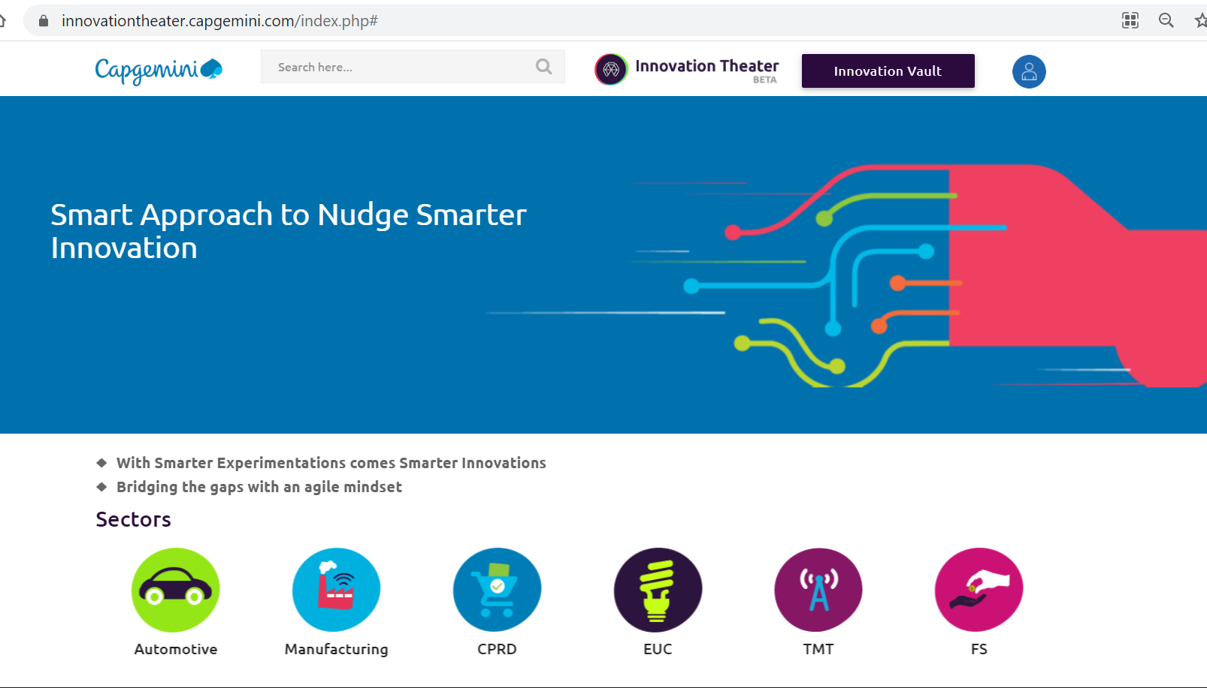
Access Innovation Theater
Make sure you are connected to the Capgemini VPN before accessing Innovation Theater. Capgemini's network is the only way to get to the Innovation Theater.
The link for the Innovation Theater is: https://innovationtheater.capgemini.com/index.php
The userid and password for Innovation Theater are not required. The Innovation Theater user database is linked to your Office 365 account. If you are accessing it for the first time, the system will automatically create a user profile for you.
The system will redirect you to the Innovation Theater landing page (Home Page) after the user authentication process is complete.

Slide 3
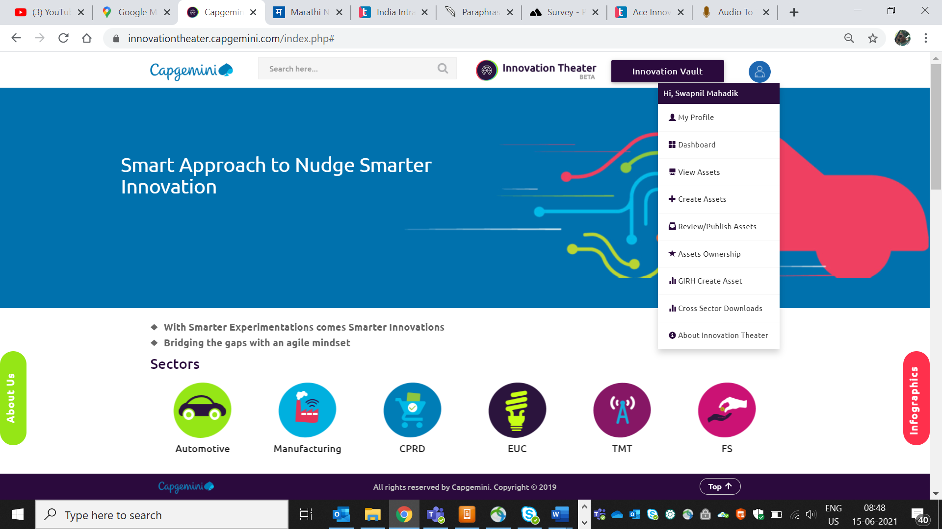
creating asset
Through the Innovation Theater menu drop down, you can reach the Create Asset menu. The menu is in the upper right corner of the window. The menu window will appear when you hover over the user profile. Please refer below screen shot:

Slide 4
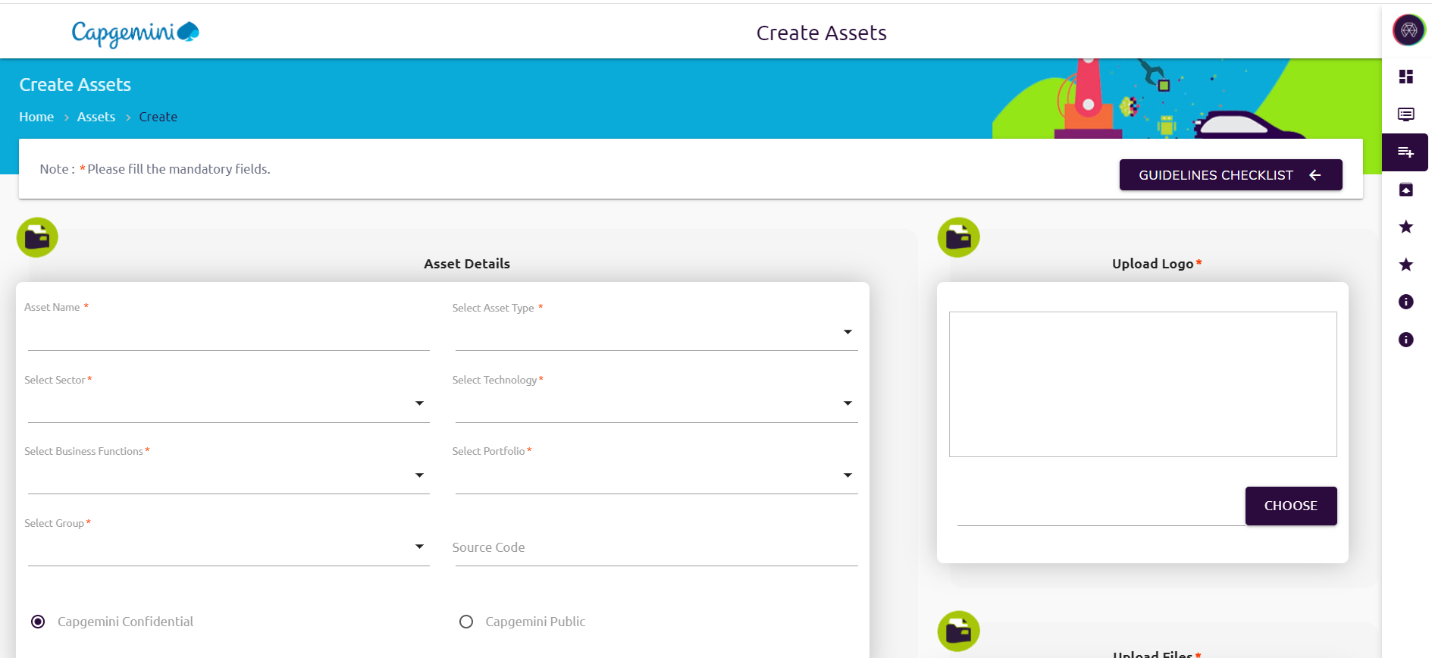
creating asset
When you select the Create Asset option from the menu, a window will pop up with all of the information needed to create an asset. The details marked with an asterisk (*) are necessary.

Slide 5
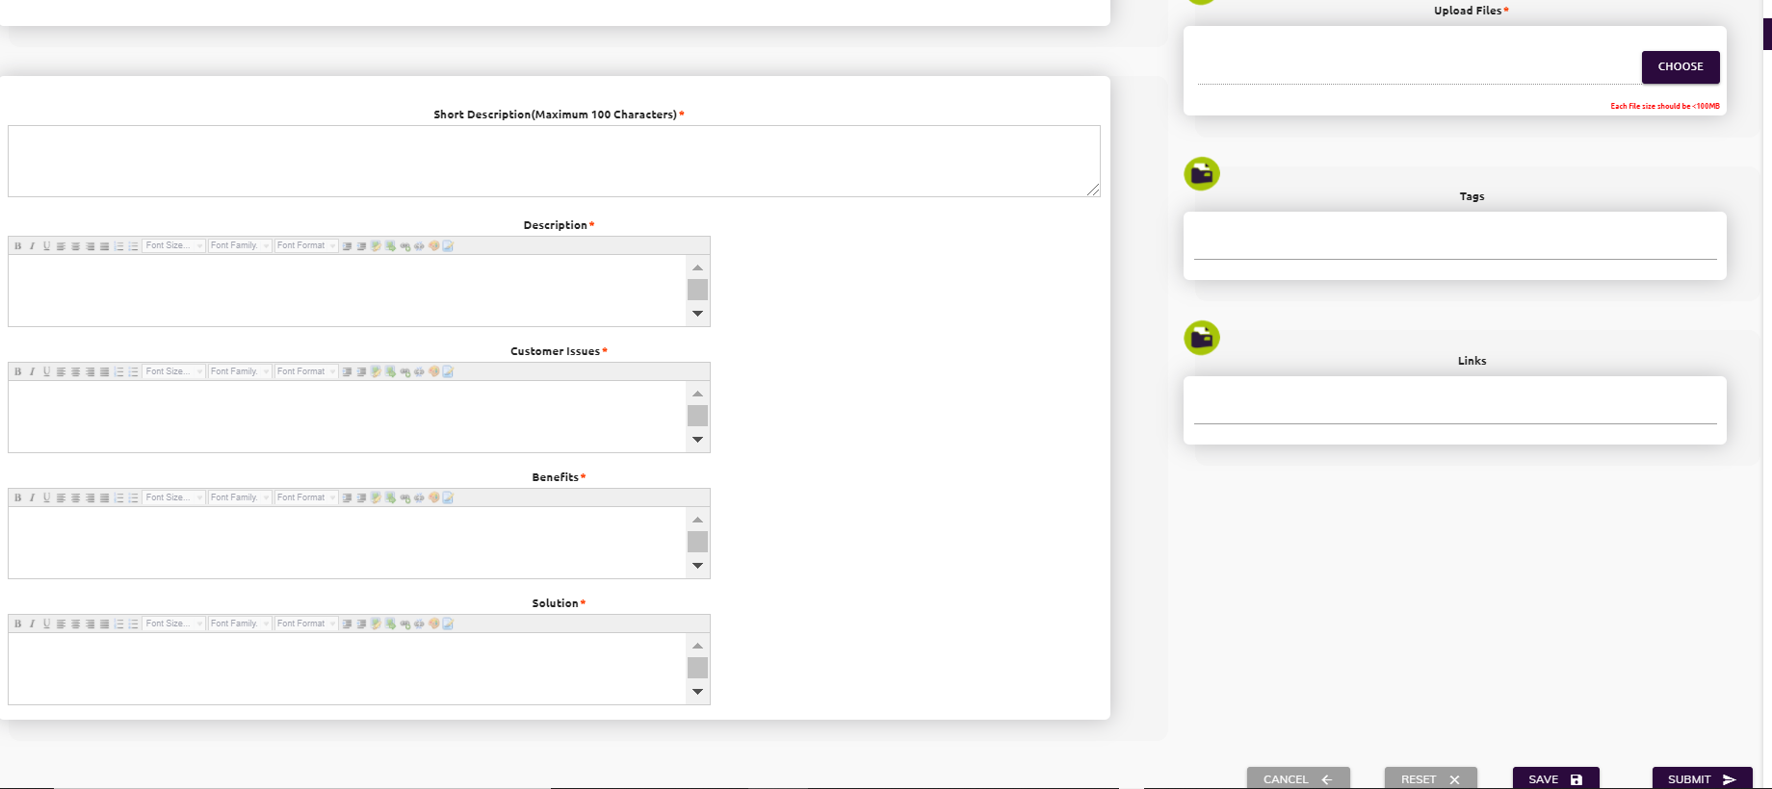
creating asset

Slide 6
creating asset
The asset requires information of the solution which help them to understand easily. There are different sections(highlighted in RED) where data is essential.
Asset Name: Describe what Asset name is should be consistent and descriptive. The name related to branding, Technology domain, and usability
Asset Type: Choose the asset type for which it should be classified. It could be a demo video, Integrators, or a tool, for example.
Sector: Choose the industry sector the solution is designed for. You have the option of selecting multiple sectors.
Technology: Choose the technology used to designed the asset. You have the option of selecting multiple technologies.
Business function: Choose the business functionality of the asset. You have the option of selecting multiple business functions.

Slide 7
creating asset
Portfolio: Choose the technology portfolio used to designed the asset. You have the option of selecting multiple portfolios.
Group: Select the business group, industry hub, or sector that built or developed the asset.
Source Code: Sharing source code should be done using the AIE Github structure. If you don't already have source code in AIE Github format, our support team can help you move it.
Short Description: The brief information about the Asset.
Description: Describe about the Asset details. The description should be easily understood. E.g. Asset belongs to which sector, what kind of customers it can be used, or technology domain, or any benchmarking with other demos
Customer Issue: Describe what the asset will address. E.g. customer challenges, a problem with customer service/product or internal processes
Benefits/Solution: Describe reasons a product or service is valuable to a customer. The details about the solution provided by Capgemini that meet new requirements, unarticulated needs or existing customer needs

Slide 8
creating asset
Logo: Describe the unique identity of the Asset and what it represents. The Logo should be simple, clear and high in resolution
Files: Describe a collection of data stored in one unit, identified by an asset name. It can be a documentation, Installation Requirements/Instructions, SpeakerNotes ,picture, audio video stream etc. The file format should be in .pdf, .ppt and/or video file(.mp4)
Links: If there is any link associated with the asset. It could be any external weblink, Youtube Video, another asset store link etc.
Tags: A tag is a keyword or term assigned to a piece of information. This kind of metadata helps describe an asset and allows it to be found again by searching.

Slide 9
creating asset
After you've filled out all of the required asset information, click "Submit" button to send the asset for approval. After submitting the asset, an email was sent to the Innovation Theater Board informing them of the new asset upload. The Innovation Theater Board is a panel of technology/sector specialists who analyse the asset information and decide whether to approve or reject it.
When the asset is approved, an email is sent to the Asset Owner informing them of the approval status, and the asset is then published on Innovation Theater.
When an asset is rejected, an email is sent to the Asset Owner explaining why it was rejected. The Asset Owner must make the necessary changes and resubmit the asset for approval.
Please see the next slide for a flowchart of the asset approval procedure in better detail.
If you have any questions or require additional information, please contact us at innovationtheater.in@capgemini.com

Slide 10
creating asset
Submit Assets
Asset Owner
Log into Innovation Theater
Mouse move over to the User Profile (Top right corner)
Click on My Assets and then click on Create Assets
Enter / update Asset Details
Click on Submit Button
If Rejected
AIE Board
Sent for Approval
If Approved
Innovation Theater
Publish on Portal

